Slide 1

Browsers -Getting started
JS

Slide 2
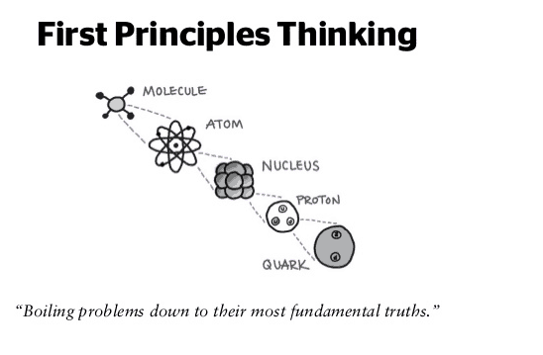

Slide 3
Installations
Text editor – Sublime / Notepad++ or IDE
GitHub account & GIT
Postman
Node
Browser
Accounts
Heroku
Netlify

Slide 4
Reads
https://stackoverflow.com/questions/1517582/what-is-the-difference-between-statically-typed-and-dynamically-typed-languages
https://stackoverflow.com/questions/17253545/scripting-language-vs-programming-language#:~:text=Scripts%20are%20generally%20written%20to,is%20use%20to%20build%20applications.&text=Some%20programming%20languages%20that%20are,code%2C%20and%20is%20subsequently%20run.

Slide 5
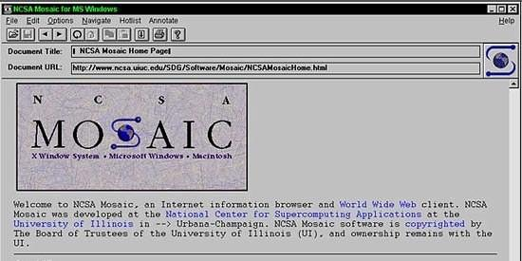
First Web Browser
Andreessen and colleagues leave NCSA to form "Mosaic Communications Corp" (Netscape).

Slide 6
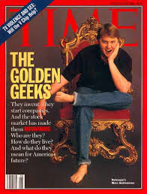
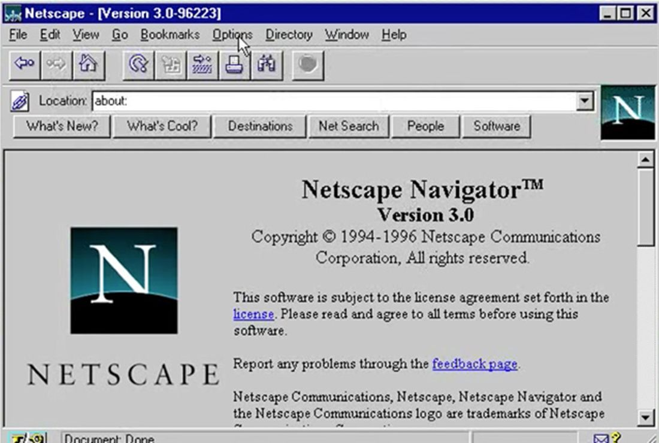
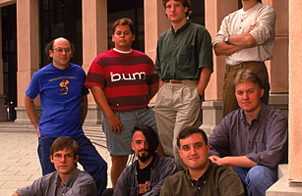
http://www.internethistorypodcast.com/2014/04/on-the-20th-anniversary-an-oral-history-of-netscapes-founding/

Slide 7
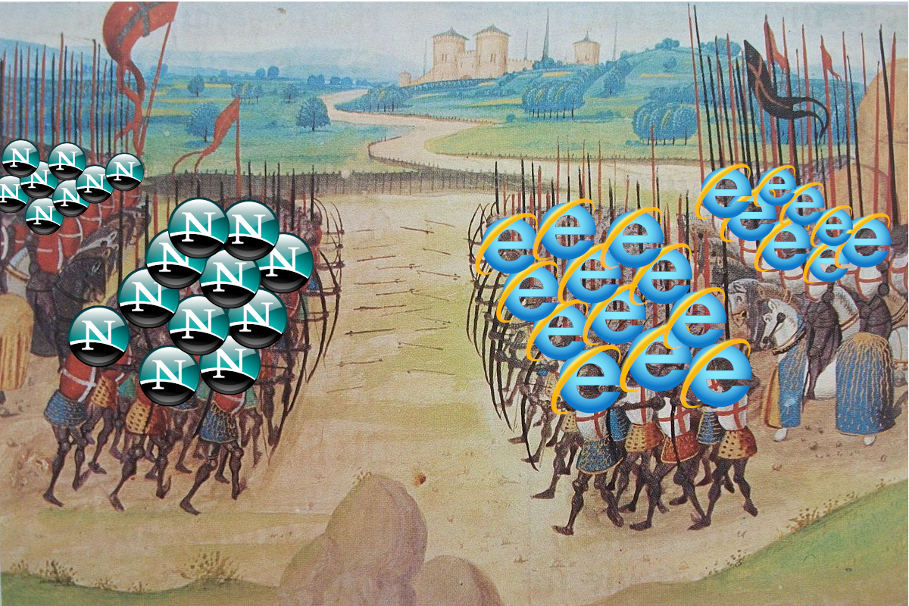
Browser Wars https://www.youtube.com/watch?v=VANORrzKX50
Src: https://medium.com/@traciemasek/a-brief-history-of-the-original-browsers-and-the-first-browser-war-7823fdf756fe

Slide 8
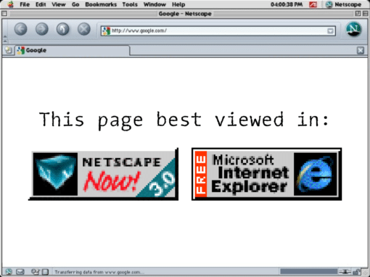

Slide 9
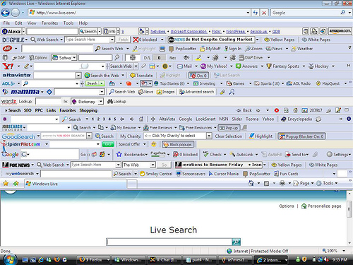

Slide 10
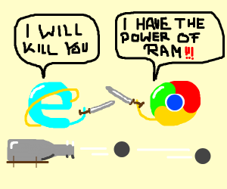
Browser War II

Slide 11


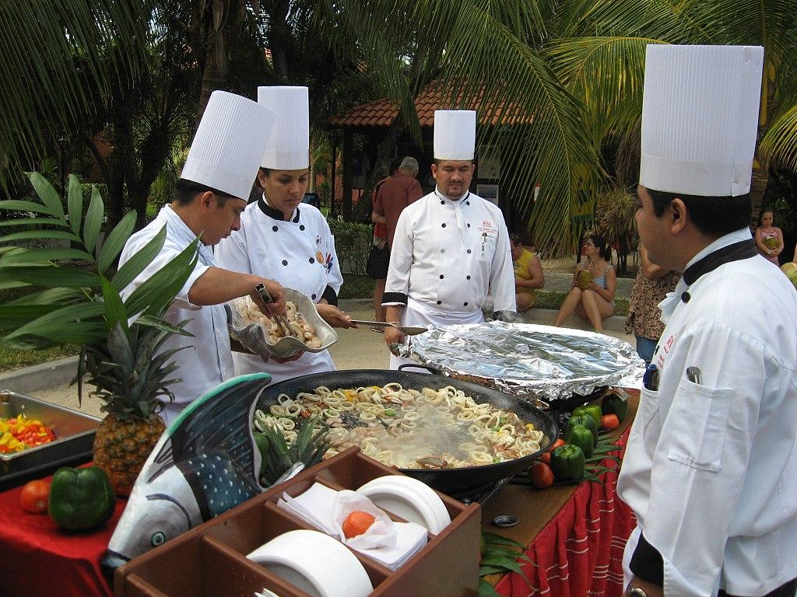
FRONT-END
BACK-END / SERVER
DATABASE

Slide 12


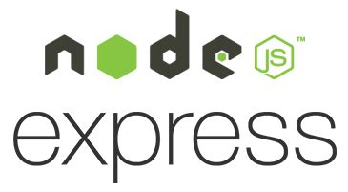
WEB ARCHITECTURE

Slide 13




Translator/ Compiler

Slide 15
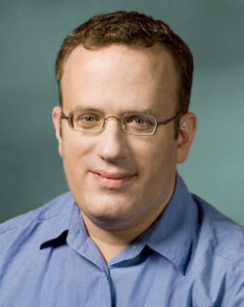
What is JavaScript?
Created by Netscape - 1995
Originally called LiveWire then LiveScript
Developed by Brandon Eich
Named to make use of Java market buzz
IE and Netscape renderings are slightly different
JScript created by Microsoft vs JavaScript
Standardized today as ECMAScript

Slide 16
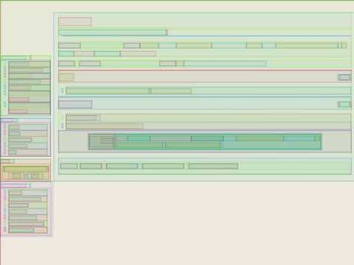
Browser Layout Process

Slide 17
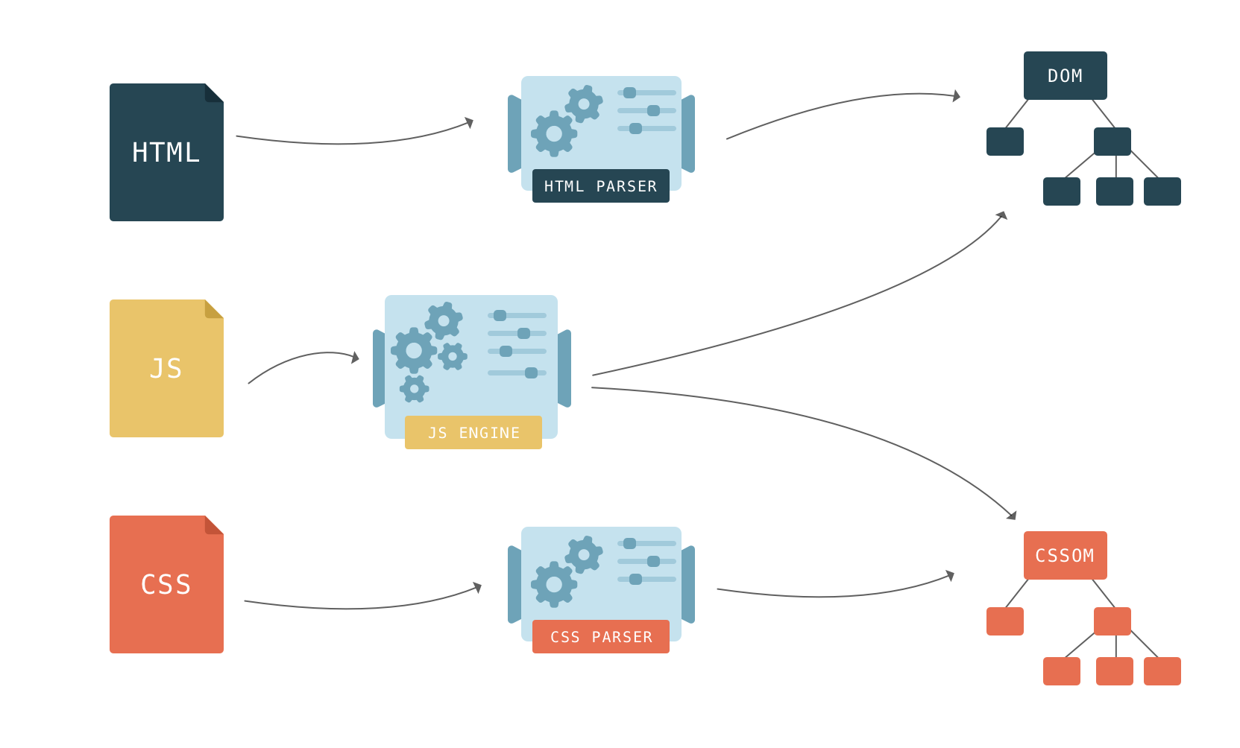


Slide 18
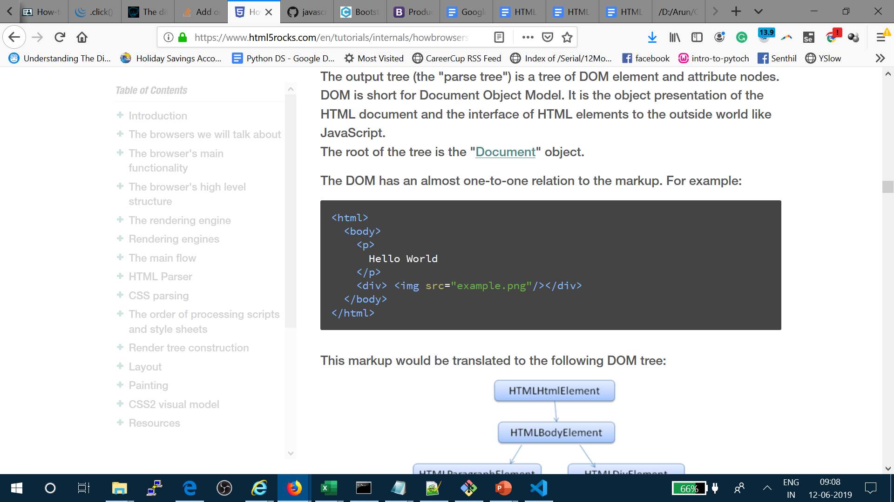
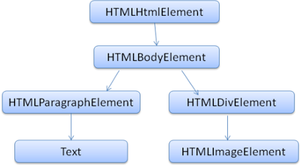

Slide 19
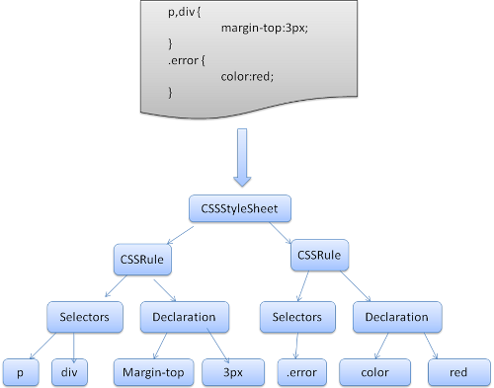

Slide 20

Structure of a Web Browser
User Interface
Browser Engine
Data Storage
Rendering Engine
Networking
JS engine
UI Backend

Slide 21
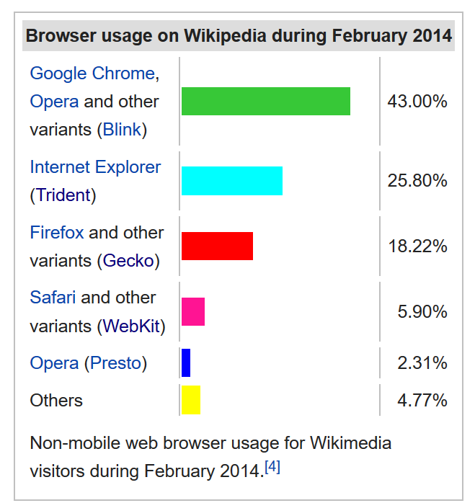
Layout engine or rendering engine

Slide 22
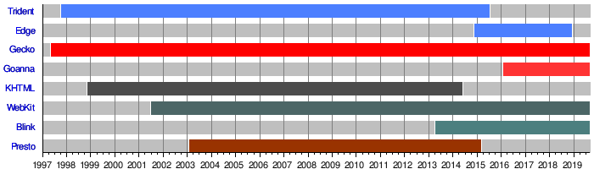
Layout engine or rendering engine

Slide 23



Rendering Engine
JS Engine
In 2020
Blink
V8
Gecko
SpiderMonkey
Before 2020
Trident – IE
EdgeHTML - Edge
Chakra
Webkit
Nitro

Slide 24
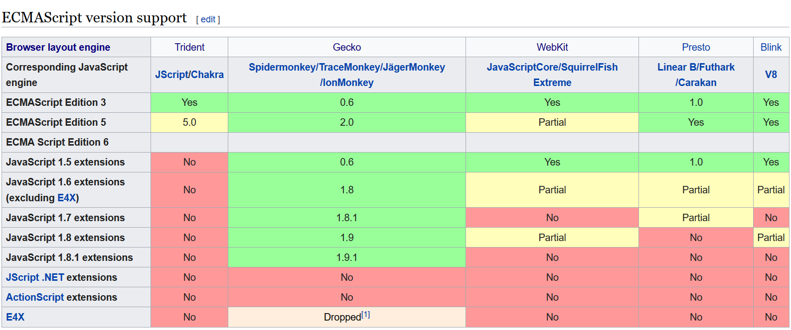
JavaScript engine or ECMAScript engines

Slide 25
Java
Scheme
Self
JavaScript
Programming Paradigms
https://cs.lmu.edu/~ray/notes/paradigms/#:~:text=A%20programming%20paradigm%20is%20a,thing%20(like%20a%20language).

Slide 26
Design of JS - JavaScript
2 simple ideas
Key : Value - Everything
Asynchronous – I wont Block your work

Slide 27
JavaScript - Sandboxed
JavaScript - Stripped
Browser
Nodejs
JavaScript

Slide 28
Operation Sysatn
Operation Sysatn
Operation System
Operation System
Chrome Browser
Chrome Browser
<Script>filename.js</Script>
node filename.js
JavaScript - Sandboxed
JavaScript - Stripped
Chrome Browser
Node.exe
JS engine – V8
JS engine – V8
JavaScript – Run in FE
JavaScript – Run in BE

Slide 29
Google Chrome
Blink
Fork of WebKit
C++
Developed in-house by Google as part of The Chromium Project, a project “to open-source the code for the Google Chrome browser”
https://docs.google.com/document/d/1aitSOucL0VHZa9Z2vbRJSyAIsAz24kX8LFByQ5xQnUg/edit
V8 - Developed in-house by Google as part of The Chromium Project - Used in Node.js!
Mozilla Firefox
Gecko - Developed in-house by Mozilla - Written in Rust!
SpiderMonkey - The first JavaScript engine in history. Developed by Brendan Eich, the creator of JavaScript, while he was at Netscape.

Slide 30
Safari
WebKit - Created by Apple as a fork of the KHTML and KJS engines from Konqueror, a web browser developed by KDE.
Nitro (formerly SquirrelFish)
Edge
EdgeHTML - A fork of Internet Explorer’s Trident that was made not-shitty.
Chakra - Open-sourced as ChakraCore. - In 2016, Microsoft created a PR in the Node.js GitHub repo to use ChakraCore instead of V8. This PR was expanded out into its own project and now lives here as a project of the node organization.

Slide 31
Opera
Blink
- Fork of WebKit. Part of Chrome
V8
If something works on Google Chrome, you can expect it to work on Opera due to the identical rendering engine + JavaScript engine used.
Internet Explorer
Trident
Chakra

Slide 32
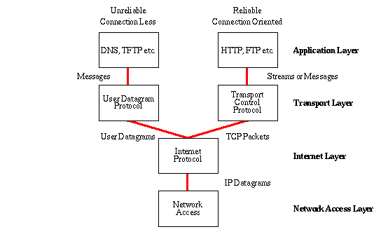
Common Internet protocols
TCP/IP
HTTP / HTTPS
FTP

Slide 33
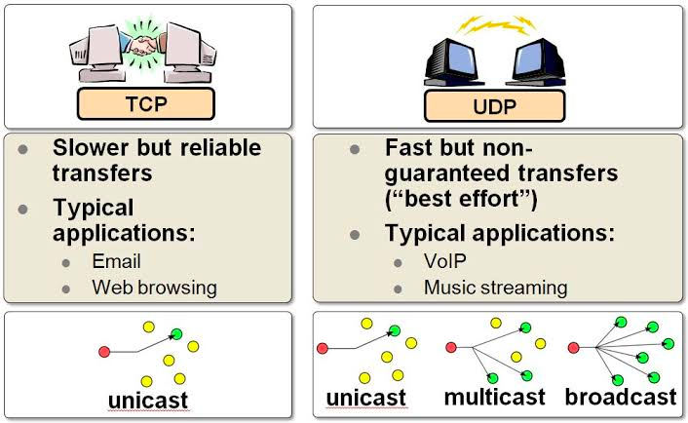

Slide 34
IP – MAC address – Ports ➔ Discussion
Why IP address when we have MAC address
Why they are called as ports ? Why we need ports?
IMEA – MAC
IP – Mobile Number
Port – USB / C-type

Slide 35
HTTP
Hypertext Transport Protocol
Language of the Web
protocol used for communication between web browsers and web servers
TCP port 80 (443 secure)
RFC 2616 (ver 1.1)

Slide 36
Evolution of HTTP
HTTP/0.9 – The one-line protocol
GET /mypage.html
HTTP/1.0 – Building extensibility
HTTP headers
HTTP/1.1 – The standardized protocol
More than 15 years of extensions
HTTP/2 – A protocol for greater performance
HTTP/3 - HTTP over QUIC
http://www.http2demo.io/

Slide 37
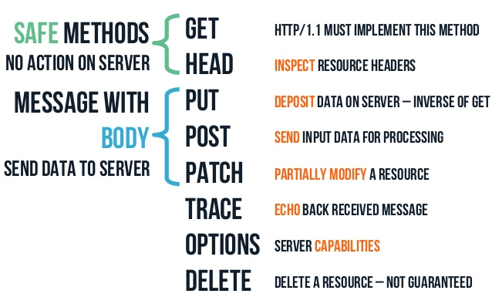
HTTP methods

Slide 38


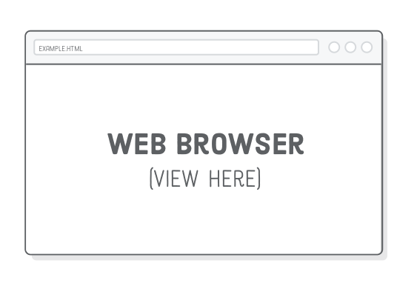


How the Server looks at the URL
Get /index.html
http://234.23.45.6:80/index.html
HTTP request
http://www.guvi.io
HTTP response
(content)
Default browser method is GET

Slide 39
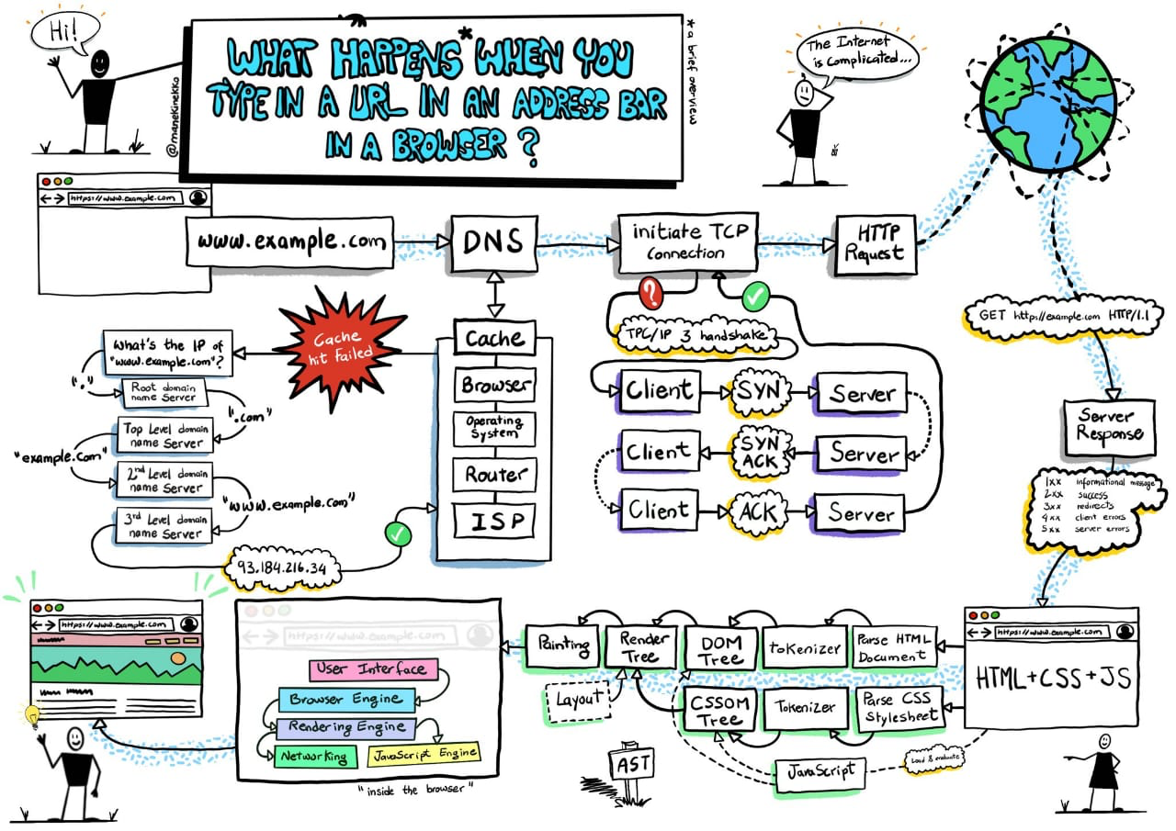

Slide 40
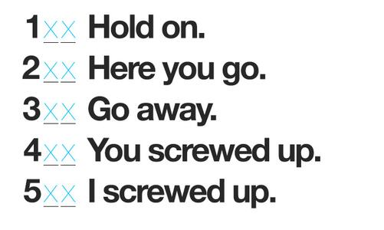
HTTP Return codes

Slide 41
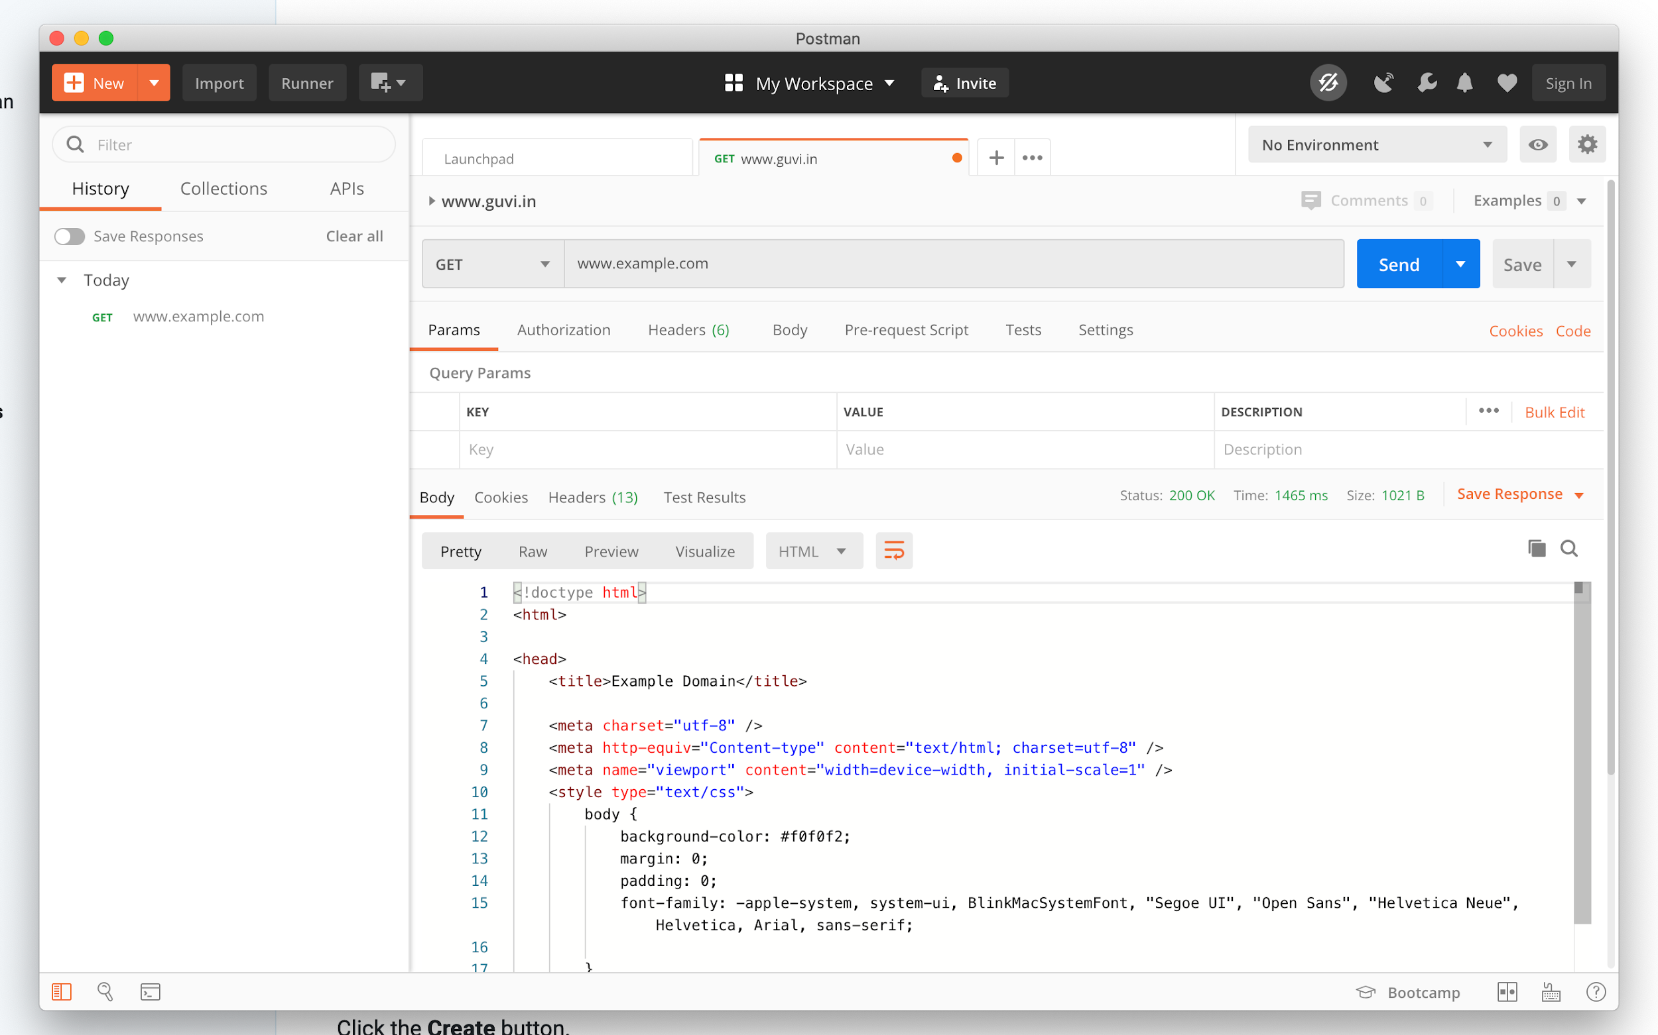

Slide 42
Tasks
Difference between HTTP1.1 vs 2
https://www.youtube.com/watch?v=SmE4OwHztCc
List 5 difference between Browser JS(console) v Nodejs
JSONserver – fake server with POST
https://www.youtube.com/watch?v=-4r0W7TtVTY
Host JSON server in Heroku –
https://github.com/reach2arunprakash/json-server-heroku

Slide 43
Thanks

